Slide 1

to our presentation

Slide 2



FreeThinkers
Team members:​
Tamanna Akter
Id: 221-15-5298
Mahamudul Hasan Shanto
Id: 221-15-6013

Slide 3

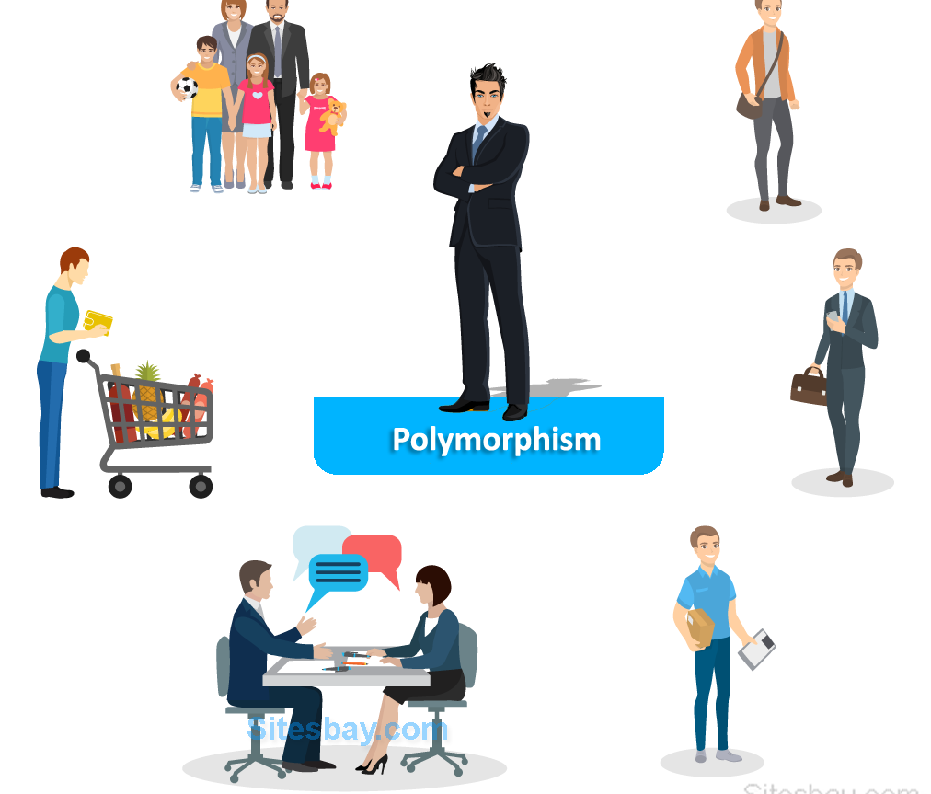
Presentation topic : Polymorphism

Slide 4

Polymorphism
Poly - many
Morphism – form
Polymorphism = Manyform

Slide 5

Programmers code can be reused via Polymorphism.
2. Supports a single variable name for multiple data types. 3. Saves a lot of time. 4. Easy to debug the codes.

Slide 6
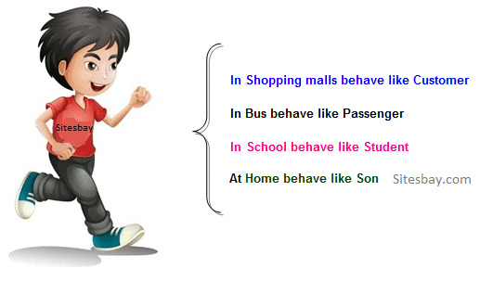
Real life example of polymorphism
Samba

Slide 7
Polymorpism
Compile time (static or early binding)
Method overloading
Operator overloading
Runtime (dynamic or late binding)
Method overriding

Slide 8
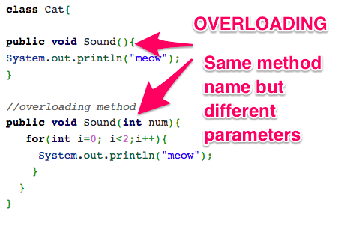
Method overloading

Slide 9
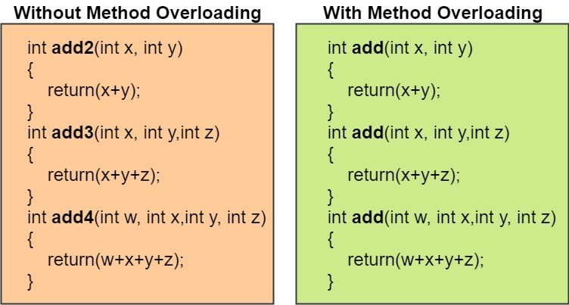

Slide 10
Different ways to overload the method
By changing number of argument
By changing the data type
public class MethodOverloading {
void sum(int a, int b)
{
System.out.println(a+b);
}
void sum(int a, int b, int c)
{
System.out.println(a+b+c);
}
public static void main(String args[]){
MethodOverloading obj = new MethodOverloading();
obj.sum(20,20);
obj.sum(10,20,30);
}
}
public class MethodOverloading2 {
void sum(int a,int b)
{
System.out.println(a+b);
}
void sum(double a, double b)
{
System.out.println(a+b);
} public static void main(String args[]){
MethodOverloading2 obj=new MethodOverloading2();
obj.sum(10.5,10.5);
obj.sum(20,20);
}
}

Slide 11
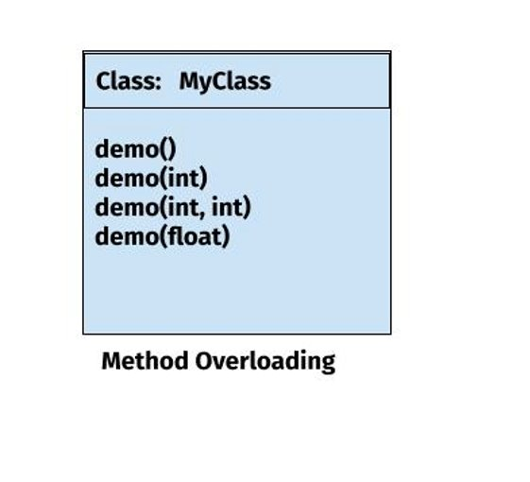
UML diagram of method overloading

Slide 12
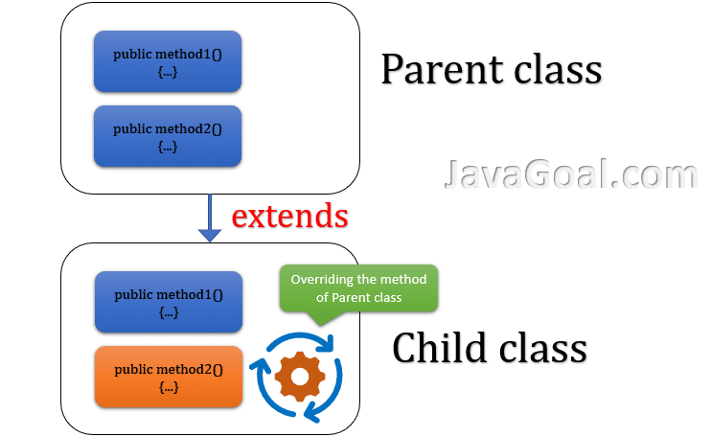
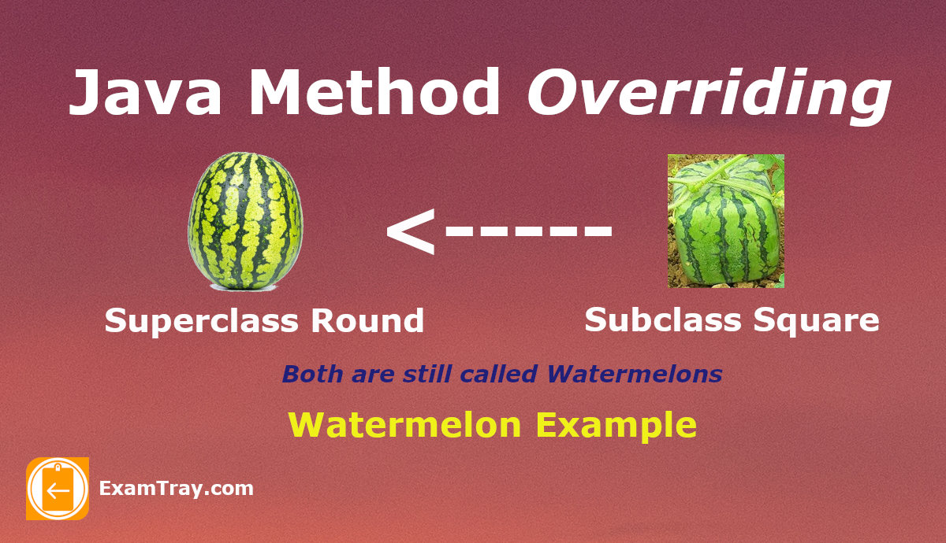
Method overriding

Slide 13
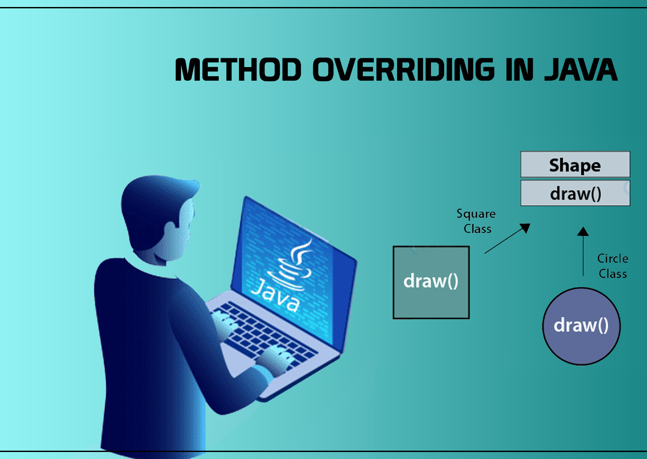
Rules for,
The method must have the same name as in the parent class
The method must have the same parameter as in the parent class.
There must be an IS-A relationship (inheritance)

Slide 14
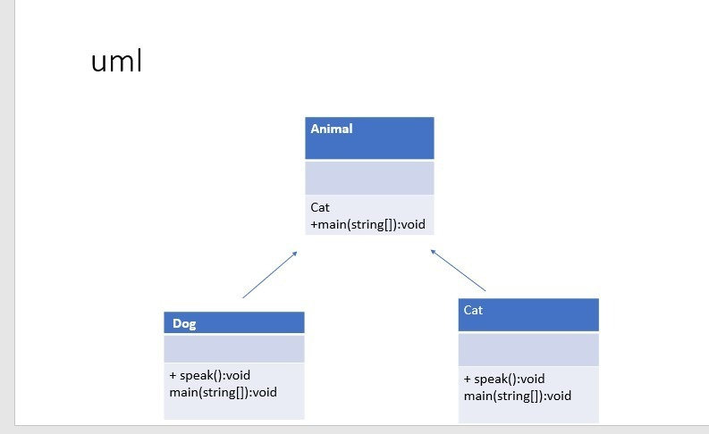
UML diagram:
+speak():void

Slide 15
Example code of method overriding
class Animal {
public void speak() {
System.out.println("The animal makes a sound"); }}class Dog extends Animal {
//Override
public void speak() {System.out.println("The dog barks"); }
}class Cat extends Animal {
//Override
public void speak() { System.out.println("The cat meows")}}
public class Main {
public static void main(String[] args) {
Animal a = new Animal();
Dog d = new Dog();
Cat c = new Cat()
a.speak(); // The animal makes a sound
d.speak(); // The dog barks
c.speak(); // The cat meows
}
}

Slide 16
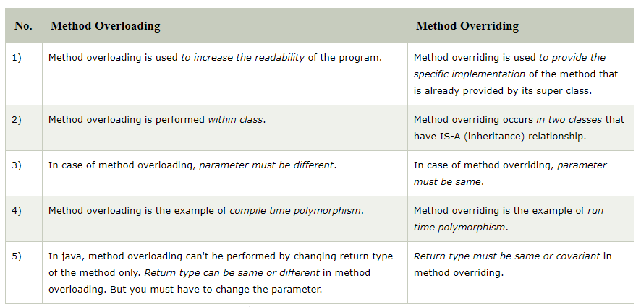
method overloading vs method overriding

Slide 17


